Slide 1
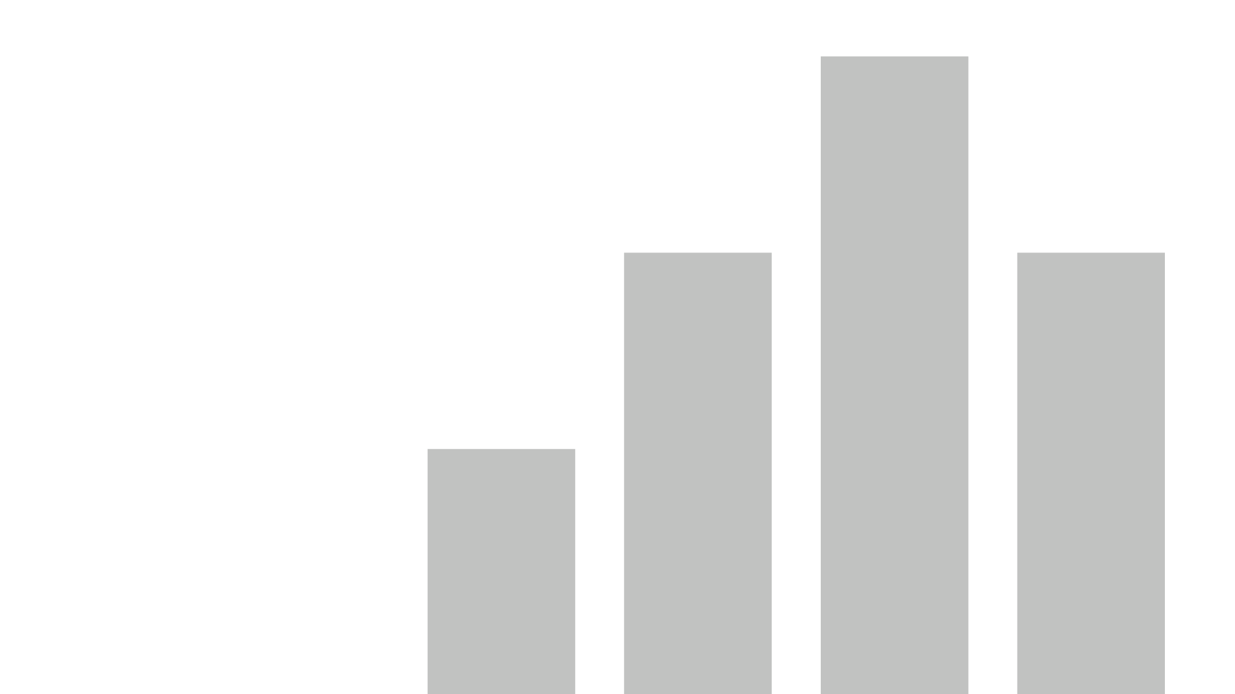


UniCorn Dataset
View in Power BI
Last data refresh:
1/27/2023 9:48:49 AM UTC
Downloaded at:
1/27/2023 10:01:34 AM UTC

Slide 2
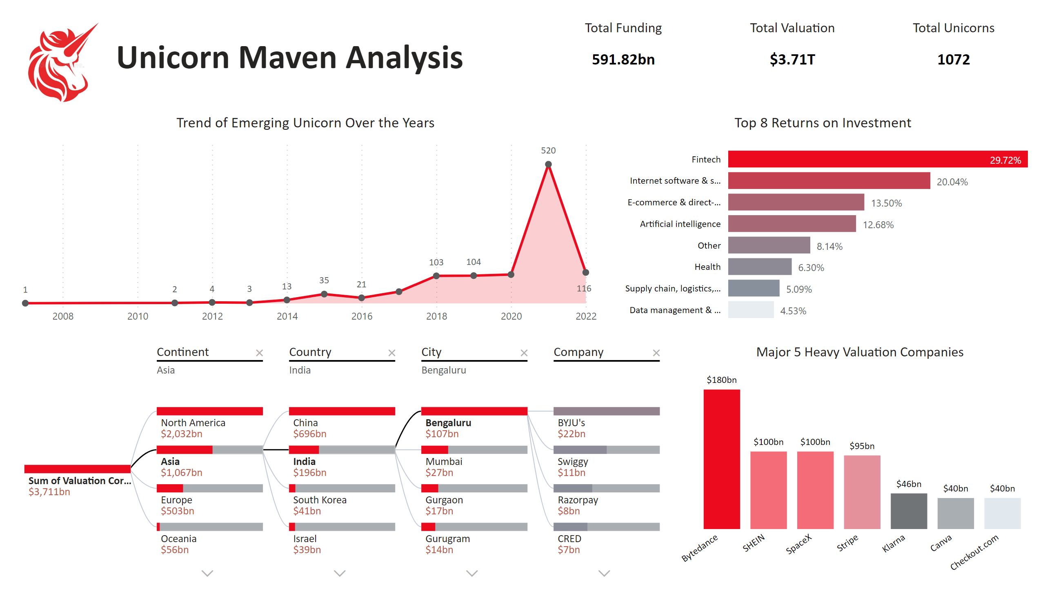
Unicorn Summary
Notes:
decompositionTreeVisual
No alt text provided
Total Funding
No alt text provided
Total Unicorns
No alt text provided
Total Valuation
No alt text provided
Top 8 Returns on Investment
No alt text provided
Major 5 Heavy Valuation Companies
No alt text provided
Trend of Emerging Unicorn Over the Years
No alt text provided
image
No alt text provided
textbox
No alt text provided

Slide 3
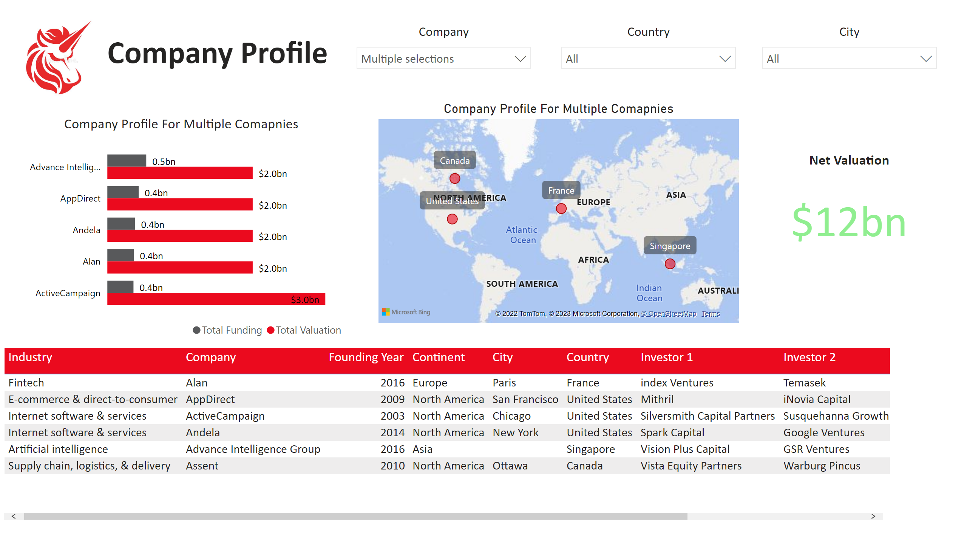
Company Profile
Notes:
image
No alt text provided
textbox
No alt text provided
Company
No alt text provided
Company Profile For Multiple Comapnies
No alt text provided
Company Profile For Multiple Comapnies
No alt text provided
tableEx
No alt text provided
Country
No alt text provided
City
No alt text provided
Net Valuation
No alt text provided

